Slide 1
Notes:
Good morning everyone Before we start, I just want to thanks our sponsor that made this event possible

Slide 2
Automate your load testing using Azure DevOps, K6 and Log Analytics
Session subtitle
Ivan Porta
Tommaso Stocchi
@GTRekter
@tommasodotNET
Notes:
My name is Ivan Porta, I’m a customer engineer at Microsoft and today I’m here with my collegue Tommaso Stocchi to talk about how to Automate your load testing using Azure DevOps, K6 and Log Analytics
If you have any question,just pop us a tweet or a message and we will try to answer asap.

Slide 3
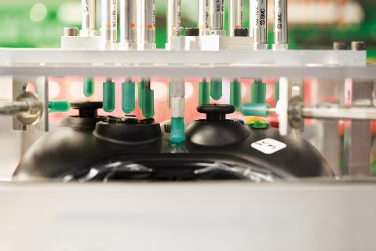



A test for every taste
How fast will the application code perform?
How will the application behave in front of the expected users load?
What is point of users-load that will break your application?
Will the application be able to scale up to the expected future capacity?
Performance testing
Load testing
Stress testing
Capacity planning
Notes:
So, When we develop an application there are many things that we have to keep in considerations, for example:
How fast will the application code perform?
How will the application behave in front of an expected users load?
What is point of users-load that actually will break the application?
Will the application be able to scale up to the expected future capacity?
And each one of these question have a specific test or activity that aim to give you the information you need to answer and be sure that you are delivering a good quality software.
For example,
Performance testing: focuses on the performance of your source code
Load testing: focuses on the application’s stability and reliability under both normal and peak load conditions.
Stress testing: focuses on reaching the breaking point of your application by putting the application under unrealistic loads While load testing tests your application under realistic average or peak loads, stress testing tests it under conditions that far exceed realistic estimates.
Capacity planning: Focus on verify that the application will scale up to the future capacity.
In today’s session we are going to focus on load testing. The second block.

Slide 4
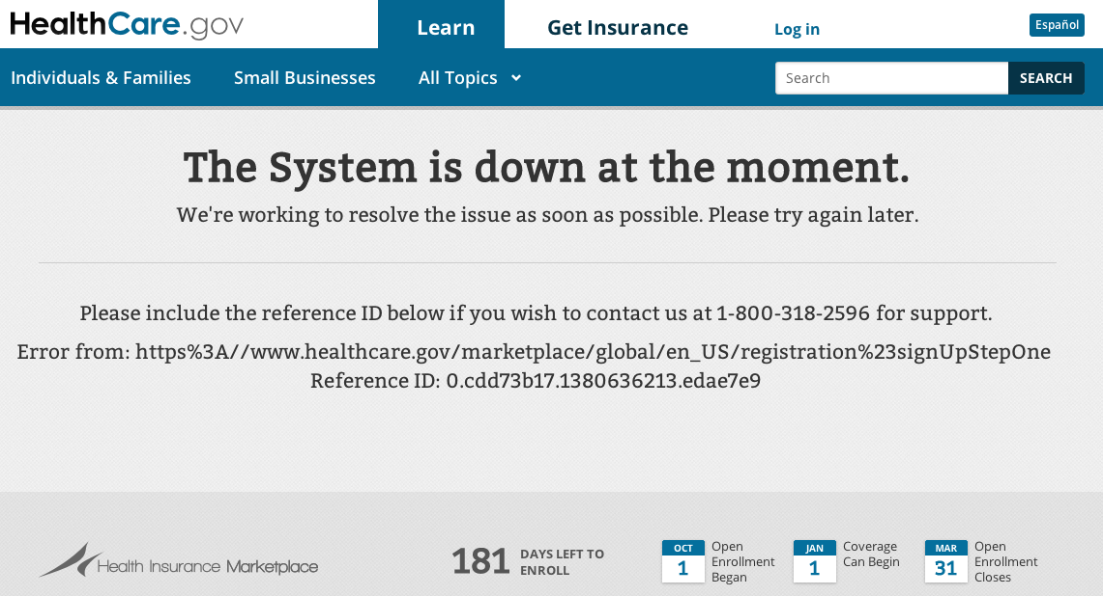
Why load Testing?
Notes:
So why is load testing important?
If you live in the United States probably this is the last thing that you would like to see.
When 2010, the government of the United State rolled out of the Obamacare individual mandate, thousands and thousands of people rushed to the website to enroll the health program.
As result the system which development’s cost was estimated over $600 million crushed and the entire Healthcare.gov website went down making impossible to the users to login and enroll.
The government started an investigation and there were claims that:
the code for the website was poorly written
never tested
Used an outdated technology
The HHS Secretary Kathleen Sebelius was also called to testify in front of a Congress to explain what has happened.
Obamacare website goes down for repairs - CBS News President Obama Addresses Healthcare Website Problems - Guardian Liberty Voice (guardianlv.com)
Retooled Obamacare website traffic surges but problems remain (yahoo.com)

Slide 5
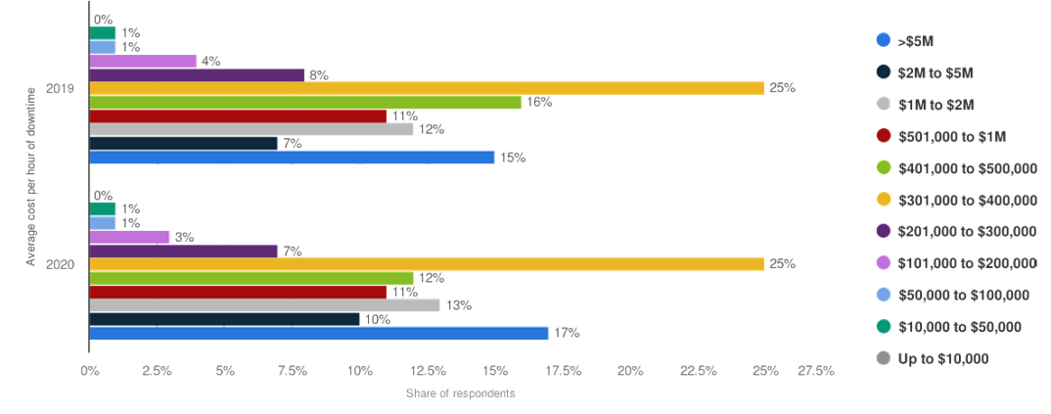
Why load Testing?
Notes:
For those of you who don’t have to deal with the American health care system or likes colorful graphs, this slide might be more interesting. In today’s world, both enterprises and consumers rely on digital applications for crucial functions.
For this reason, even a small failure can be costly both in terms of reputation and money.
For example, imagine if Amazon did not know the amount of traffic that its servers could sustain; it would fail to supply requests from its customer during peak seasons like Black Friday.
You might think that this event is unlikely.
However, according to a survey taken by Gartner (a global research and advisory firm), in 2020, 25% of respondents reported the average hourly downtime cost of their application was between $301,000 and $400,000. Furthermore, 17% said it cost them $5M per hour. Global hourly enterprise server downtime cost 2019 | Statista

Slide 6



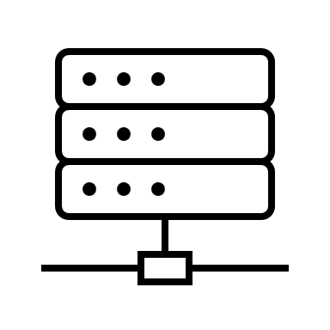

How do load testing work?
Notes:
How do load testing work?
On one had we have your developers. They write the actual tests that the tool is going to perform.
Then you start the test by clicking a button on a UI or executing a command on your command prompt
The tool will simulate a specific number of virtual users (might be hundreds or even millions) by sending concurrent requests to your target machine and measuring insights like:
response times,
throughput rates,
resource utilization levels,
and more.
Once the tests is over, the tool will then create a summary showing these metrics
It’s important to understand that the number of virtual user’s should be a realistic number (this is one of the main differences from stress tests). For example, according to your analysis you expect 100k users on your ecommerce on Christmas with random peeks around 200k.

Slide 7
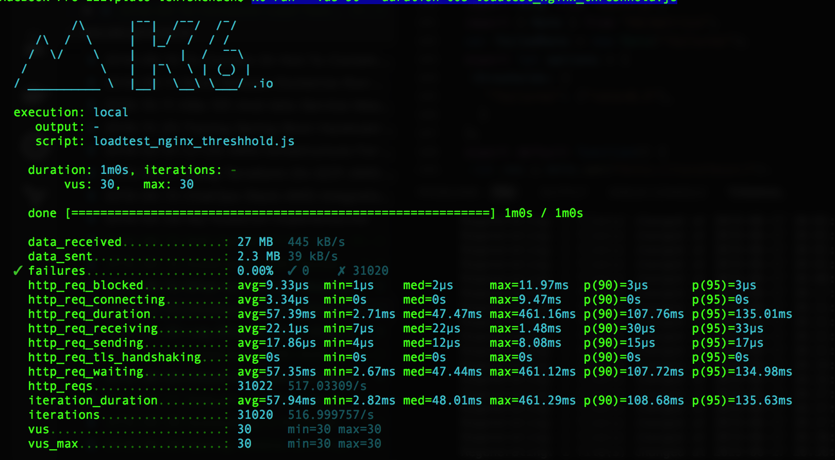
How does load testing work?
Notes:
At the end you will have some metrics like these (depending on the tool that you are using).

Slide 8

Load test with k6
Open source.
k6 is an open-source load testing tool written in Golang that embeds a JavaScript runtime.
It can run a huge amount of traffic on a single computer, reducing the need for complex distributed testing infrastructure.
Already dockerized.
Support both scripting in ES6 JS and protocols like HTTP/1.1, HTTP/2, WebSocket and gRPC.
Very easy to integrate into CI/CD
Notes:
Now that we know why load testing are important and how they work, let’s move into some tools….in particular k6.
k6 is an open-source load testing tool written in Go that embeds a JavaScript runtime to allow developers to write performance tests in JavaScript.
By default, can connect and talk to the target server over TLS
It’s docker friendly
Support HTTP/1.1, HTTP/2, WebSocket and gRPC protocols
It’s also support checks and thresholds for easy and flexible CI configuration!
Last but not least, In June 2021 k6 also became part of Grafana Labs.
With offers a flexible metrics storage and visualization: InfluxDB (+Grafana), JSON or k6 Cloud
https://grafana.com/
https://github.com/grafana/k6

Slide 9
Why k6?
1.4M
Number of libraries
12.4M
Number of developers using JavaScript worldwide
$24.8K
Average cost of reskilling per person
Most used languages among software developers globally 2021
Sources: Statista.com, SlashData
Notes:
As ai mentioned in the previous slide there are many load testing tools out there, for example: Jmeter, Locust, Fiddler, nGrinder, Gatling
So why are we here today talking about k6?
According to a survey taken by Statista.com on which programming language was most commonly used by software developers around the world, we can see that.. As of 2021 JavaScript is the most commonly used programming languages among software developers, with nearly 65 percent of respondents stating that they used JavaScript.
It’s can boast more that 1.4 Million libraries
According to a survey taken by SlashData, JavaScript, CoffeeScript and Microsoft's TypeScript, reached around 12.4 million developers worldwide.
You might say, even if my dev team are not familiar with javascript, well they can learn a new programming language? What’s the big deal?
According to a 2019 paper from the World Economic Forum. The cost of reskilling in the United States — which includes funding learning design, training materials and subject matter expertise — is approximately $24,800 per person. This is only for the training, you have to consider the time this person in not actually working
https://www.javascript.com/ https://www.statista.com/statistics/793628/worldwide-developer-survey-most-used-languages/
https://www.slashdata.co/free-resources/developer-economics-state-of-the-developer-nation-19th-edition https://www.benefitnews.com/list/cost-effective-ways-to-upskill-and-reskill-employees

Slide 10
Why k6?
K6 is Code-driven; it gives you huge flexibility when writing your tests
Can run a huge amount of traffic on a single computer.
Utilizes very less resources from the system compared to other tools.
Being able to execute your test from a single machine makes running k6 through your CI pipeline a lot more straightforward, as you don’t have to setup additional injectors.
If you can extract more load out of one machine, it is easier for developer to run the same CI/CD bits locally.
Notes:
Load testing can be tricky because, especially with large-scale tests with thousands or even millions of virtual users
(just think about websites like amazon or well…Facebook when was still up and running).
As mentioned earlier these virtual users that later will generate traffic to your application are generated from a machine and like every machine it need RAM and CPU.
The problem here is that as the number of VU increase, you machine might suffer from a lack of computational power.
As result, you may either see that:
your load test becomes unable to go above a certain number of requests per second
or you may see that response time measurements become completely unreliable.
To solve this problem, you can scale vertically or horizontally your VM, but another option is to use a tool that is less hungry of resources like k6.
By doing so:
Not only you will save money (don’t have to scale your VM)
But also, you will make it easier to your developers to integrate it with your CI/CD.
In this graphs you can see some measurements takes with a
Machine in the load generation side: 4-core Celeron server running Ubuntu 18.04 with 8GB RAM
Target machine with a simple Nginx server: 4Ghz i7 iMac with 16G RAM with some a Google spreadsheet open in a browser, but made sure nothing demanding was happening while tests were running.
I usually fire up an Nginx server and then I load test by fetching the default "Welcome to Nginx" page.
How many requests per second could each tool generate in this lab setup?
Here working with most parameters available, but primarily concurrence (how many threads the tool used, and how many TCP connections) and things like enabling HTTP keep-alive, disabling things the tool did that required lots of CPU (HTML parsing maybe), etc. The goal was to cram out as many requests per second out of each tool as possible.
Several of the tools are quite memory-hungry and sometimes memory usage is also dependent on the size of the test, in terms of virtual users (VUs). High memory usage per VU can prevent people from running large-scale tests using the tool. Thanks to the usage of Gorourines offered by Go, a single instance of k6 is often enough to generate load of 30.000-40.000 simultaneous users (VUs). This amount of VUs can generate upwards of 300,000 requests per second (RPS). Unless you need more than 100,000-300,000 requests per second (6-12M requests per minute), a single instance of k6 will likely be sufficient for your needs.
https://k6.io/docs/testing-guides/running-large-tests/ https://k6.io/blog/comparing-best-open-source-load-testing-tools/#memory-usage-per-vu-level

Slide 11
Setting up k6
macOS
Windows
Docker
Linux
$ brew install k6
choco install k6
$ docker pull loadimpact/k6
$ sudo apt-key adv --keyserver hkp://keyserver.ubuntu.com:80 --recv-keys C5AD17C747E3415A3642D57D77C6C491D6AC1D69
$ sudo apt-get update
$ sudo apt-get install k6
Notes:
Before leaving the stage to Tommaso I just want to give you a quick side note on how easy is to install k6.
With just one or few lines of code you can setup the tool on your local machine.
With this I have finished, Tommaso the stage is yours.

Slide 12
DEMO

Slide 14
Q&A

